Slide 1

Models Implemented
XGBoost
LightGBM
Deep NN with dense layers
Used both TensorFlow and PyTorch
TCN
RNN
Notes:
CDD: Thanks Claribel, I’ll now discuss the various models we implemented during the competition.
The first two models we tried were XGBoost and LightGBM – they are similar in that they are both gradient boosting models utilizing decision trees. The advantages of these models for this competition were that easy to get started with even without any tuning. Decision trees also support Null values without issue meaning that we did not need to figure out how to handle missing values in order to get started. The downsides for these models for this competition is that they have no concept of using information from prior timesteps and so feature engineering and preprocessing is required to capture any time-series information. So we needed to create features like lags and moving averages in order to incorporate temporal information.
We also experimented with deep neural networks using dense layers. The advantage with DNNs was that the networks could capture relationships between features without us needing to explicitly engineer those features. However just like with the decision tree based models using dense layers meant we needed to figure out ways to engineer features that could capture relationships between observations over time. Also DNNs do not allow null values, so we needed to figure out ways to deal with missing values. We tried out building neural networks with both TensorFlow and PyTorch which both worked fine in the Kaggle environment.
As Claribel mentioned earlier we tested out a Temporal Convolutional Network which she did a great job summarizing.
The last model we tried out was a Recurrent Neural Network which I’ll go into a little more detail on our approach over the next couple of slides.

Slide 2
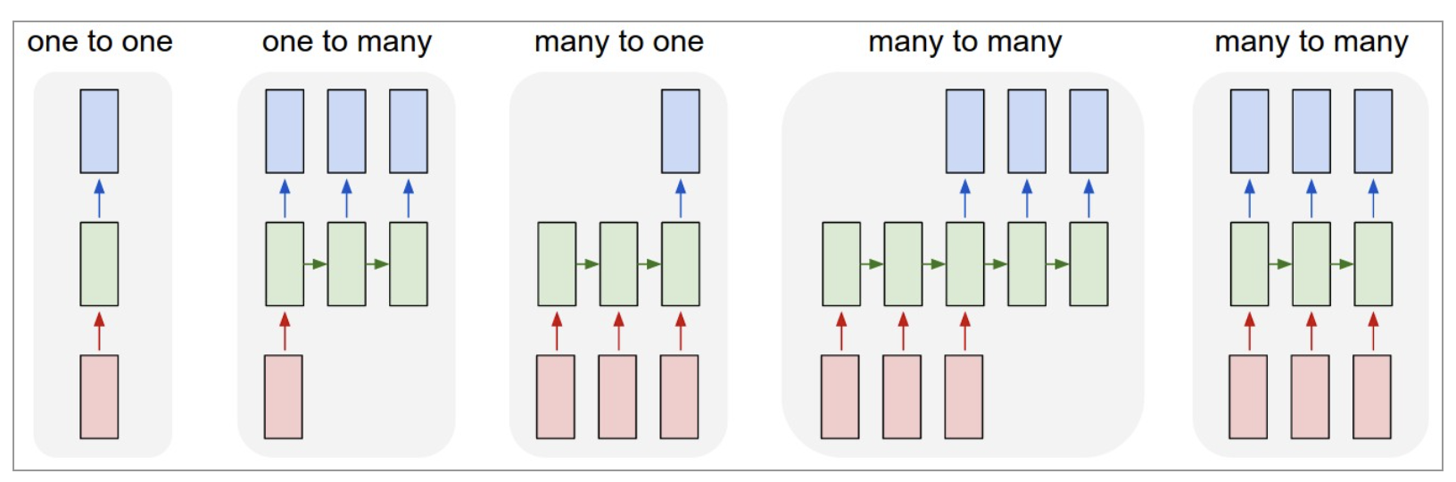
RNN model refresher
An RNN is a model that can take information from past observations and directly use them in predicting future values making it an ideal choice for time series forecasting. It is also flexible in that it can take a different number of inputs and outputs.
From https://karpathy.github.io/2015/05/21/rnn-effectiveness/
Notes:
So I won’t go into too many details explaining an RNN since we all learned about RNNs as part of this course and had a chance to implement one as part of the final Kaggle competition a few weeks ago. So just as a quick refresher, an RNN is a model that can take a sequence of observations and make predictions based on that input, but it also passes that information as input to the next timestep. So clearly it makes a good candidate for a model to use for time series forecasting.
One other thing worth mentioning is that RNNs are flexible in the way they can handle various approaches for inputs to outputs as depicted on the figure on this slide. So clearly for a time series we’ll want to take many inputs and then depending on the task we might want to produce a single prediction or multiple predictions, both of which the RNN can handle.

Slide 3
RNN implementation options
Sequence construction
How to group samples: Group by arbitrary number of samples, by stock ID, by date ID, by stock ID and date ID
Window size: How much should sequence samples overlap? Every sample, every 5 samples, etc.
How to deal with variable length sequences?
Layer construction
LSTM or GRU
Number of hidden layers
Dropout
Output
One prediction vs all 200 stock predictions per timestep
Notes:
So with all that flexibility there were several key decisions we needed to make when implementing our RNN. The first and arguably most important decision was how to construct the sequences to be passed as inputs to the model to best train. How many observations should we have in each sequence? Should we include all stocks, a single stock, some group of stocks together based on clustering? Should sequences be for a single day? A week? A month? Should we have the samples in the sequences overlap? If so how much overlap? How do we handle variable length sequences?
Besides the sequence construction there were also decisions to be made on how to construct the network layers themselves. Should we use LSTM or GRU layers? How many layers? Should we use dropout?
Finally we need to determine what the model should output. Would we make one prediction for just a single stock at each timestep? All 200 of the stocks or perhaps some subset based on clustering?

Slide 4
RNN implementation decisions
Sequence construction
Grouped by stock_id and date_id meaning that each sequence consisted of up to 55 observations for a single stock for each day.
Window size of 1 meaning maximum overlap between sequences
Used padding which was added to the beginning of sequences to ensure every sequence had 55 samples.
Layer construction
Used multiple hidden layers with 200 nodes in each hidden layer. Used GRU layers, but LSTM had similar results.
Added a dropout layer with dropout of 0.2 after each GRU layer.
Output
Based on the sequence construction we decided on a single output representing the predicted value for a given stock at each timestep.
Notes:
So on this slide I recorded the decisions we made though we did test a few of the options. For sequence construction we decided it made the most sense to make our sequences by grouping all of the observations for a single stock on a single day. Since we were predicting prices for the last 10 minutes of the trading day, and we received observations for each stock every 10 seconds until 3:59PM that gave us a total of up to 55 observations for each sequence. Since our sequences were not that large we found that when training we had enough time and memory to use the full training set and fully overlapping sequences, and so we created a sequence at every single timestep.
Since the RNN layers we implemented using tensorflow require every sequence to have the same number of samples we padded each sequence to make sure each one was 55. For example at 3:50PM there would be only 1 sample, and then at 3:50 and 10 seconds we’d have 2 samples, and it wasn’t until 3:59PM we would have the full 55 samples.
For layer construction we ended up with two hidden layers using GRU layers and 200 nodes in each layer. We also added a dropout of 0.2 after each of the GRU layers. We found LSTM had similar performance to GRU, but GRU is slightly simpler with fewer gates so we figured it would train slightly faster.
I should mention when we trained we used a batch size of 32 to speed things up as well as not use too much memory.
For our output we just made a single prediction to predict the target for that single stock ID 60 seconds from the last sample in the sequence.

Slide 5
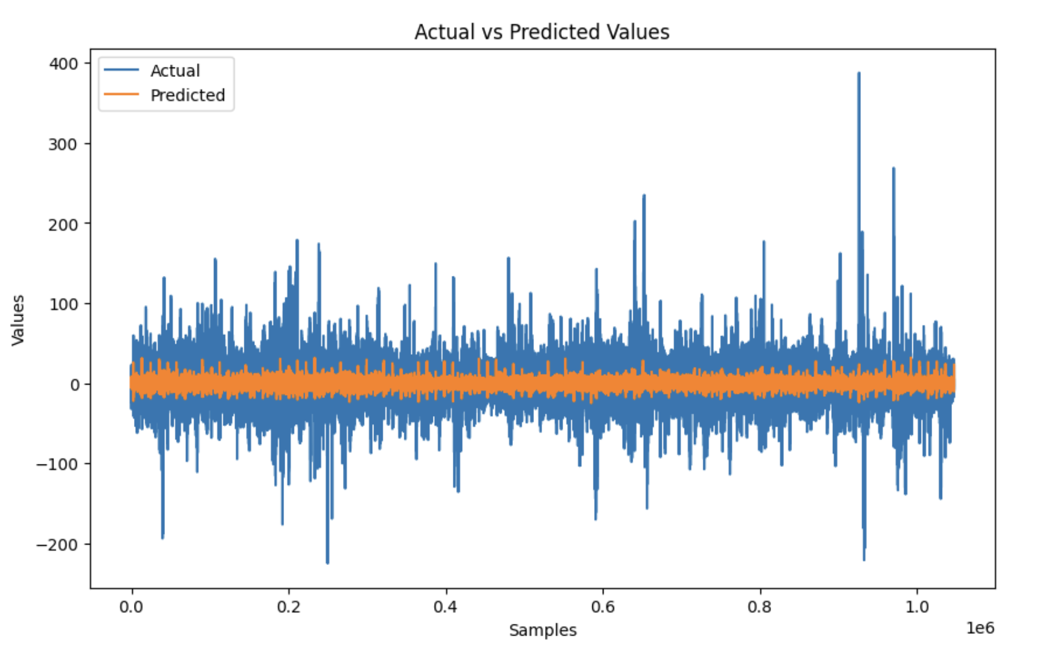
Metric Testing & Model Evaluation
We used a validation set with 20% of the training data and computed the mean average error. As we made changes this was our main indicator of whether performance improved.
We used the chart on the right comparing predicted and actual values to also sanity check the predictions made sense.
Note that the variance in predictions was much lower than the variance in the true data as a result of mean average error being the performance metric.
Notes:
When evaluating any of our models we applied the same approach.

